Slide 1
Creating cancer treatments
Designing and trialling new medicines

Slide 2
The Institute of Cancer Research
One of the world’s most influential cancer research institutes
We have an outstanding record of achievement dating back more than 100 years. We provided the first convincing evidence that DNA damage is the basic cause of cancer, laying the foundation for the now universally accepted idea that cancer is a genetic disease.
Today, the ICR is a world leader in understanding cancer biology and genetics, discovering new targeted drugs and developing new high-precision forms of radiotherapy.
The ICR’s mission is to make the discoveries that defeat cancer, and we are passionate about inspiring a diverse and inclusive next generation of cancer researchers.

Slide 3
Learning objectives
To recall the initial stages in cancer drug discovery
To describe how research scientists find drug targets, screen libraries of drugs
To explain how computerised models are used to aid the design of drugs
Recall the phases of clinical trails
Describe how research scientists test new drugs
Explain how the efficacy, dosage and toxicity of drugs determines it progression in clinical trials
Describe different types of trails
Explain how trails for cancer are different from those for other disease
Create your own clinical trail

Slide 4
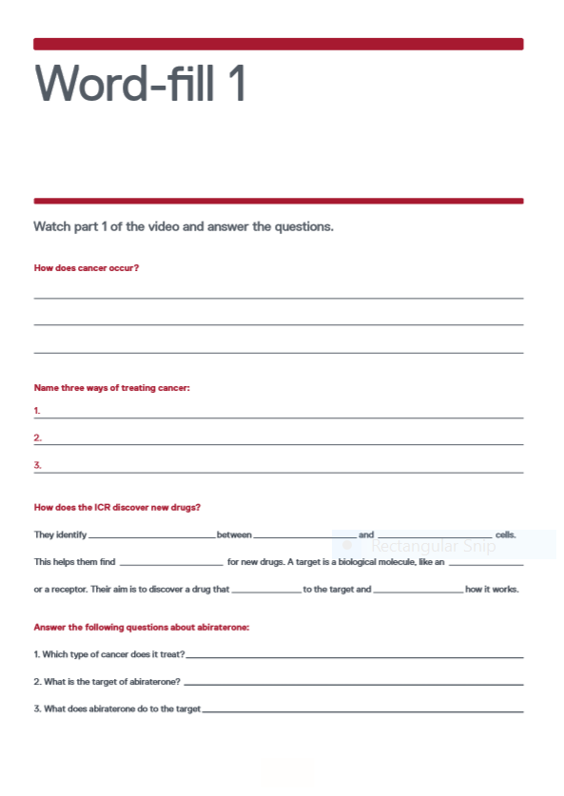
Video part 1
This part of the video covers an introduction to cancer and the initial stages in cancer drug discovery:
  finding a target
  screening a library of drugs
  the chemical properties that make a good drug.
  Task
  Watch the first part of the video, from 0:00 to 4:23.
  Complete this worksheet as you watch the video.

Slide 5
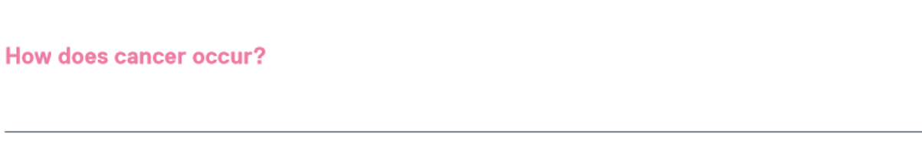
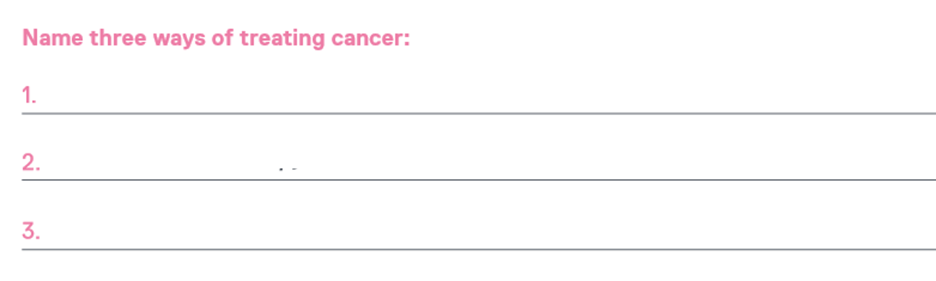
Self-assess
Cells continue to divide without stopping, producing cells when the body doesn’t need them.
Surgery
Radiation
Drugs

Slide 6
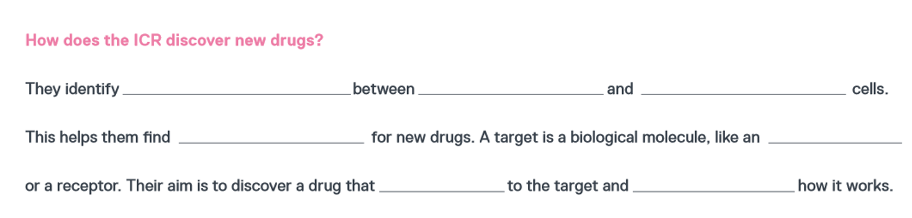
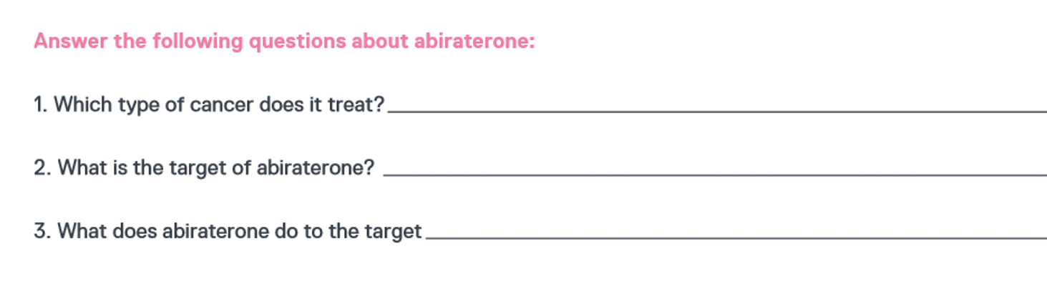
Self-assess
differences
healthy
cancerous
targets
enzyme
binds
affects
Prostate
An enzyme
Stop it making hormones that drive the cancer

Slide 7
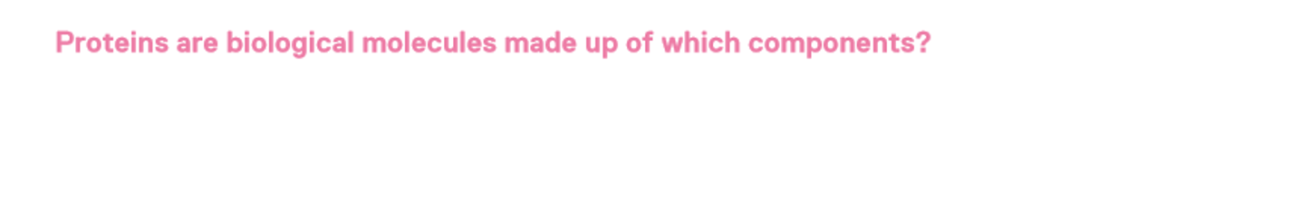
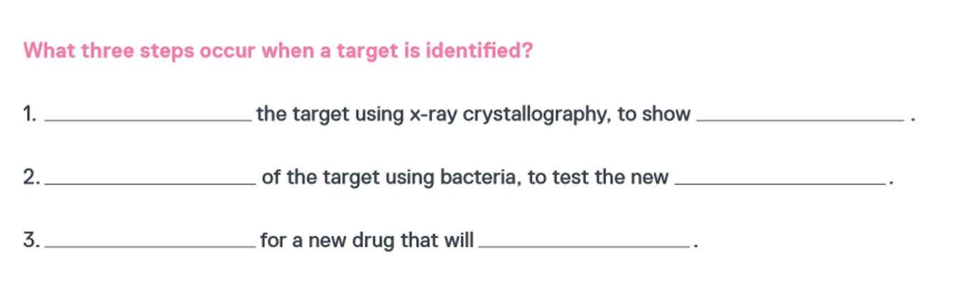
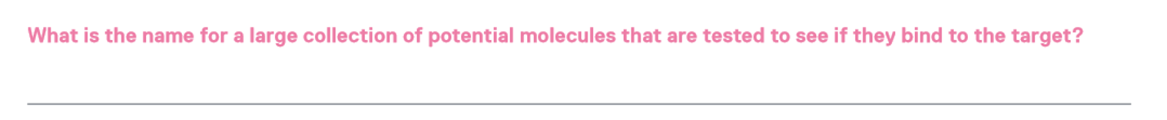
Self-assess
gylcerol
amino acids
saccharides
Analyse
what it looks like
Make copies
drugs
Search
bind to the target
A library

Slide 8
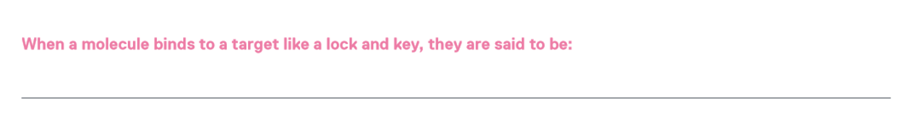
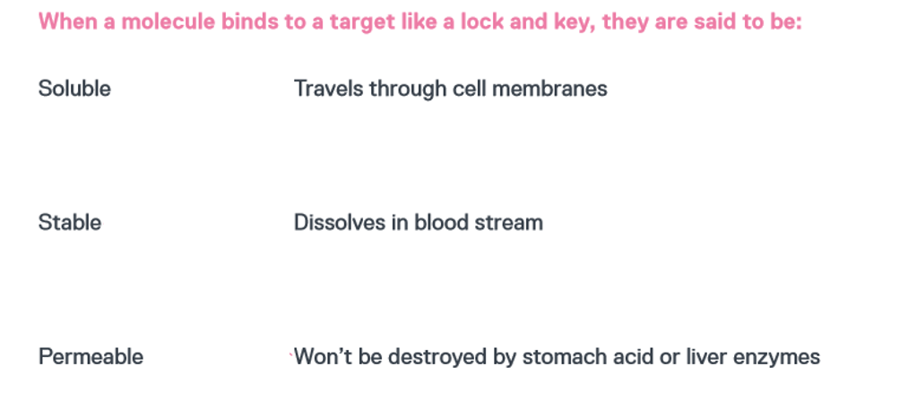
Self-assess
Complementary

Slide 9
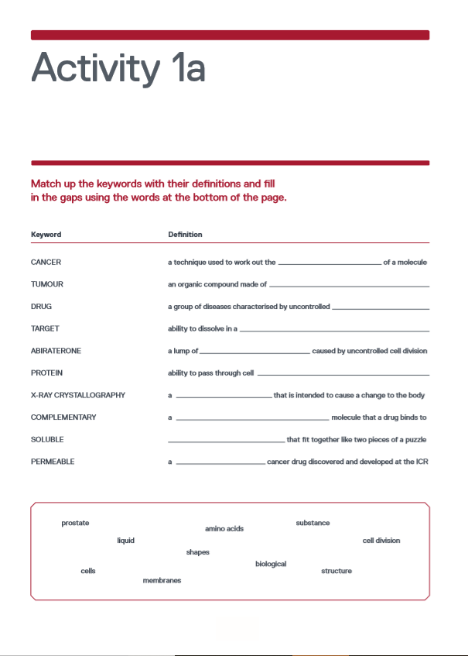
Activity 1a
  Task
  Fill in the gaps using the keywords.
  Match up the keywords to their definitions.

Slide 10
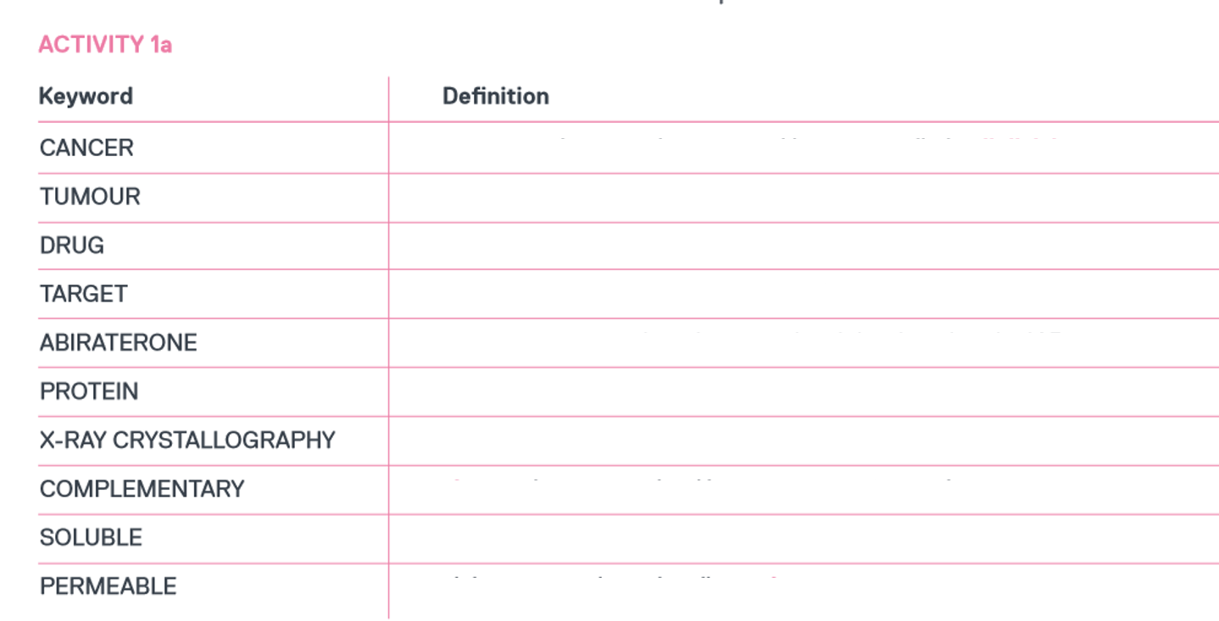
Activity 1a
  Self-assess
a group of diseases characterised by uncontrolled cell division
a lump of cells produced by uncontrolled cell division
a substance that is intended to cause a change in the body
a biological molecule that a drug binds to, to have its effect
a prostate cancer drug discovered and developed at the ICR
an organic compound made up of amino acids
a technique used to work out the structure of a molecule
shapes that fit together like two pieces of a puzzle
ability to dissolve in a liquid
ability to pass through cell membranes

Slide 11
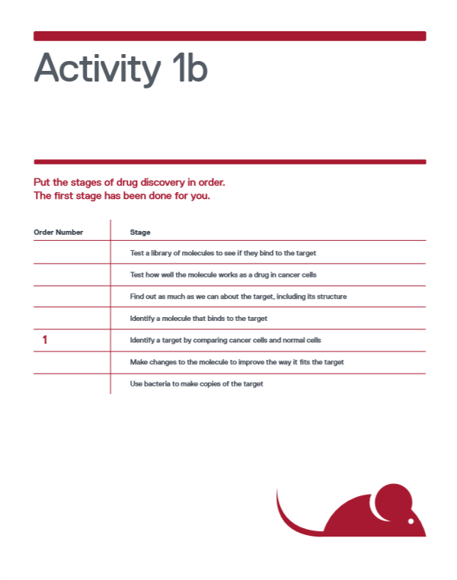
Activity 1b
  Task
  Put the stages of drug discovery in order.

Slide 12
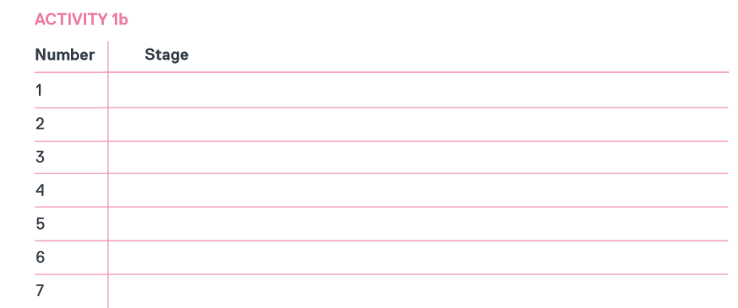
Activity 1b
  Self-assess
Identify a target by comparing cancer cells and normal cells
Find out as much as we can about the target, including its structure
Use bacteria to make copies of the target
Test a library of molecules to see if they bind to the target
Identify a molecule that binds to the target
Make changes to the molecule to improve the way it fits the target
Test how well the molecule works as a drug in cancer cells

Slide 13
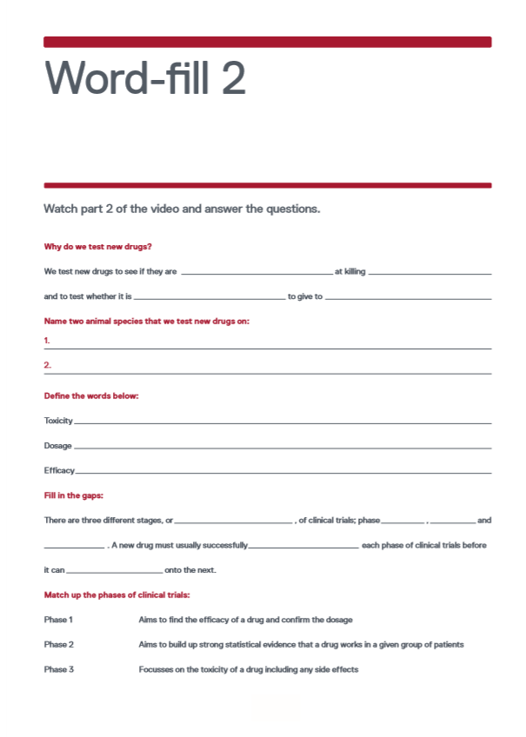
Video part 2
This part of the video covers preclinical testing in cells and animals and the phases of clinical trials.
  Task
  Watch the second part of the video, from 4:24 to 6:51.
  Complete this worksheet as you watch the video.

Slide 14
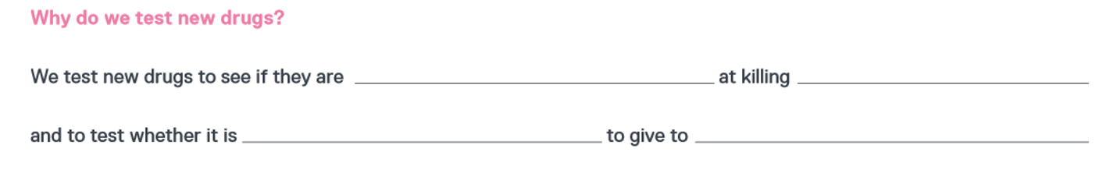
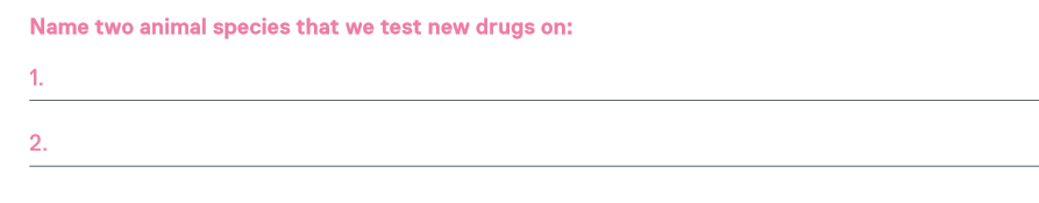
Self assess
effective
cancer cells
safe
people
rats
mice

Slide 15
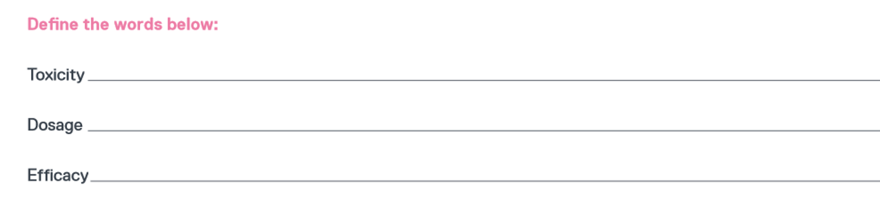
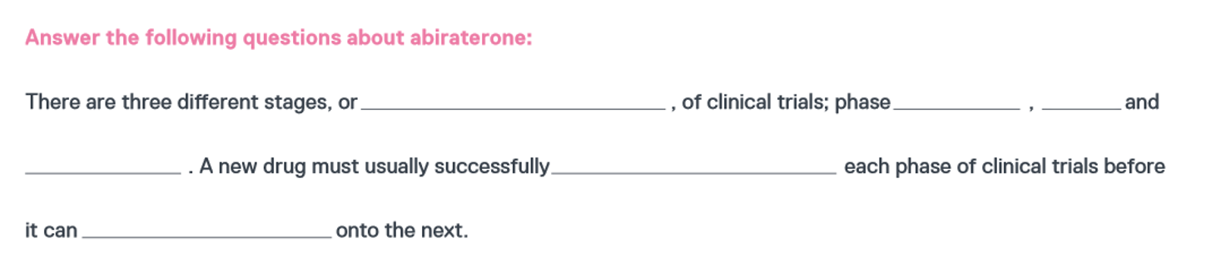
Self assess
whether a drug is dangerous for people taking it and what side effects it has
how much of a drug you should give to people
how well a drug works against a disease
phases
1
2
3
complete
progress

Slide 16
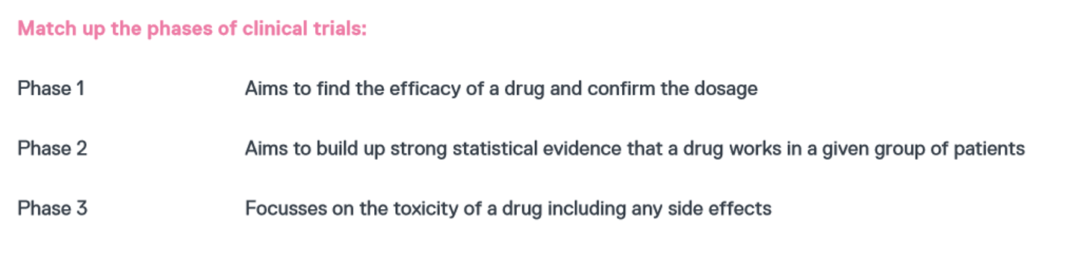
Self assess

Slide 17
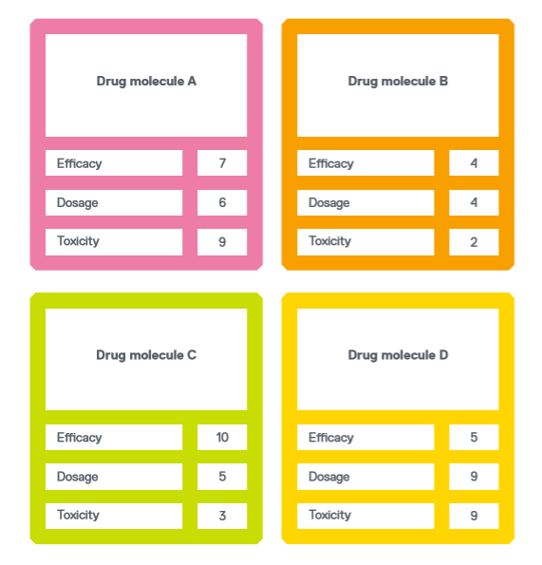
Activity 2
The cards you have been given contain information about a new drug molecule being tested. For each new drug molecule, the efficacy, dosage and toxicity of the drug have been marked out of 10.
  Task
  Compare the drug molecules on the cards and discuss which of the four drug molecules is the most likely to progress to the next stage of testing and why.

Slide 18
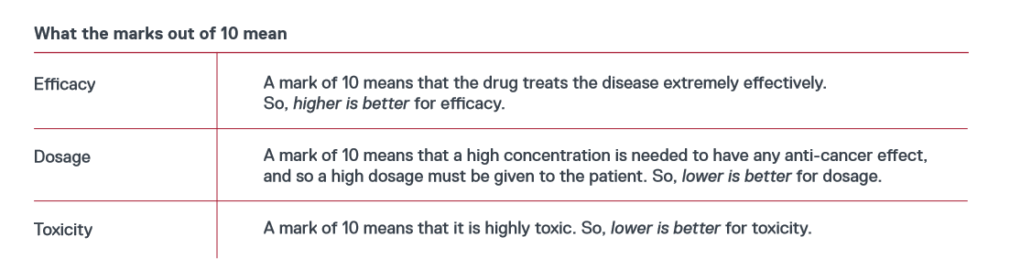
Activity 2
  Task
  Compare the drug molecules on the cards and discuss which of the four drug molecules is the most likely to progress to the next stage of testing and why.

Slide 19
Activity 2
  Peer assess
  Drug molecule C:
  It has a very high efficacy with low toxicity and low dosage. This means that the drug would be very good at destroying the cancer cells, the patient wouldn’t have to take high doses of the drug and they wouldn’t have severe side effects.
  This drug has the most favourable properties out of the four.
  Drug molecule A:
  This drug has a high efficacy, low dosage and high toxicity. This means that is destroys cancer cells very effectively and patients don’t have to take high doses of it. However, it has severe side effects.
  This drug is neither the best nor the worst. It is in the middle, along with Drug Molecule B.
Favourability
  Drug molecule B:
  This drug has a low efficacy, high dosage and low toxicity. This means that it isn’t very effective at destroying cancer cells and patients have to take high doses of the drug. However, it has few side effects.
  This drug is neither the best nor the worst. It is in the middle, along with Drug Molecule A.
Drug molecule D:
It has a low efficacy and very high toxicity and dosage. This means that the drug wouldn’t destroy cancer cells very well, the patient would have to take very high doses of the drug to get any anti-cancer effects, and they would have severe side effects.
This drug has the least favourable properties out of the four.

Slide 20
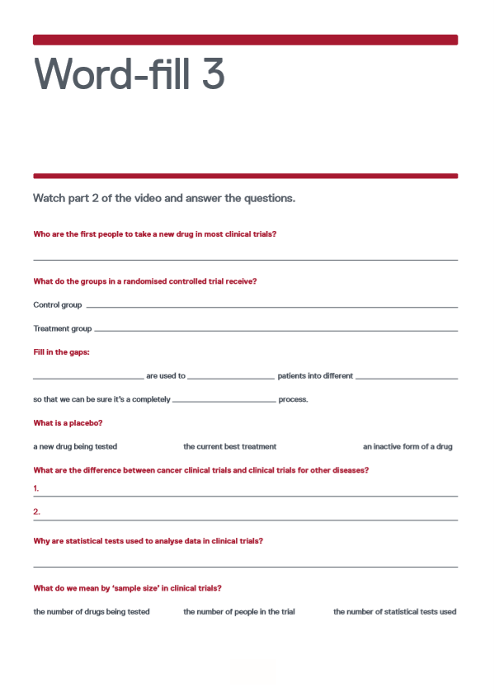
Video part 3
This part of the video covers randomised controlled trials, double-blind trials and the differences between cancer clinical trials and clinical trials for other diseases.
  Task
  Watch the second part of the video, from 6:52 to 9:50.
  Complete this worksheet as you watch the video.

Slide 21
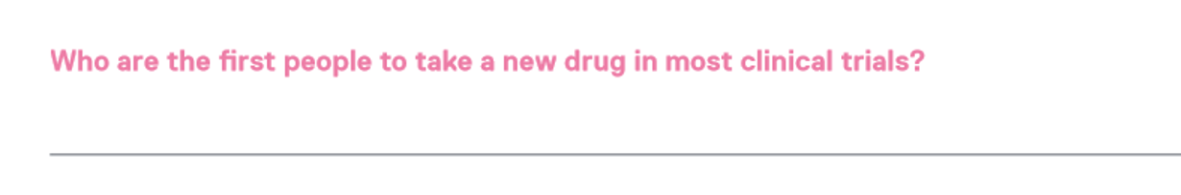
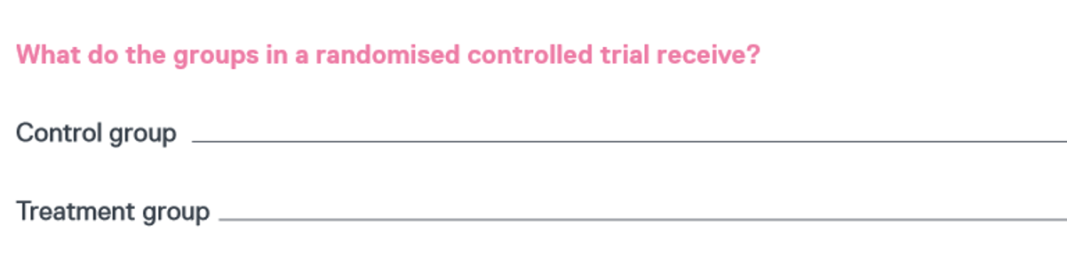
Self assess
Healthy volunteers
Standard of care
New drug

Slide 22
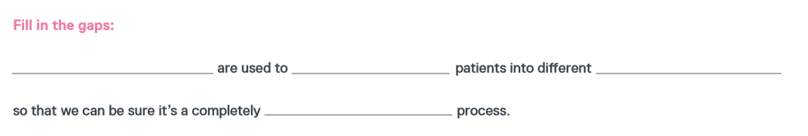

Self assess
Computer programmes
divide
groups
random
a new drug being tested
the current best treatment
an inactive form of a drug

Slide 23
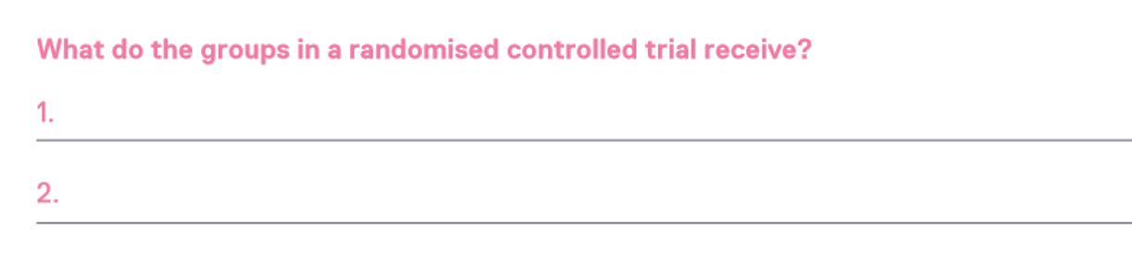
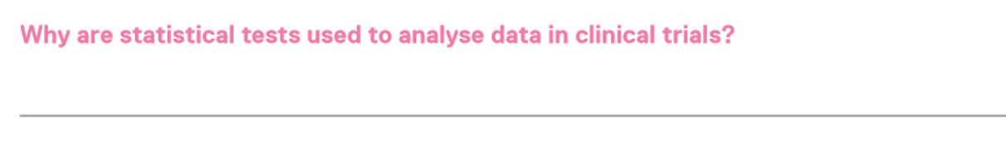
Self assess
Cancer drugs aren’t tested in healthy volunteers.
Placebos aren’t commonly used in cancer clinical trials.
To make sure the results haven’t happened by chance.

Slide 24

Self assess
the number of drugs being tested
the number of statistical tests used
the number of people in the trial

Slide 25
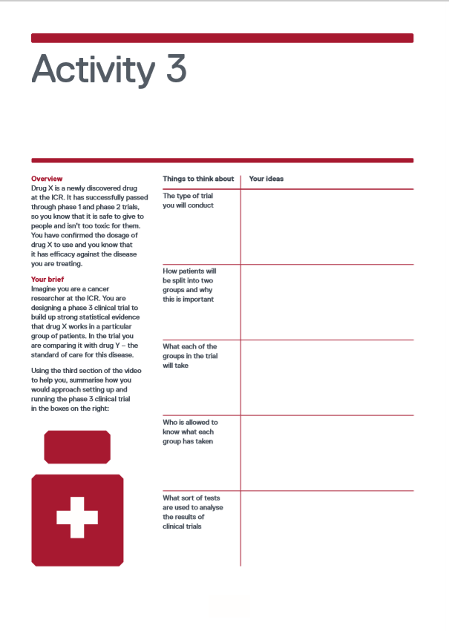
Activity 3
  Task
  Designing a phase 3 clinical trial comparing drug X with drug Y – the standard of care for this disease.
  Using the third section of the video to help you, summarise how you would approach setting up and running the phase 3 clinical trial in the boxes on the worksheet.

